Slide 1
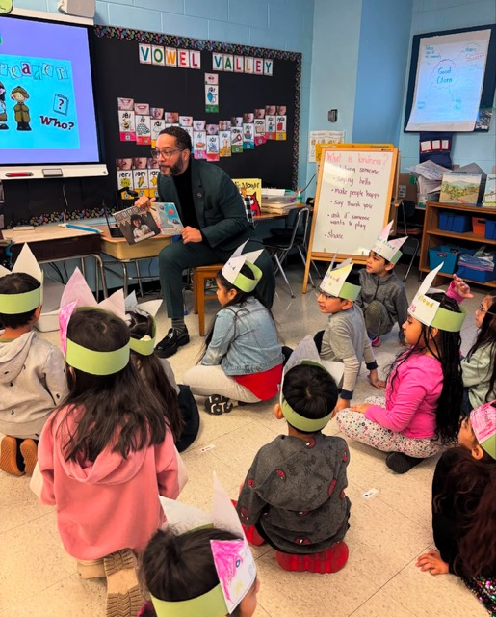
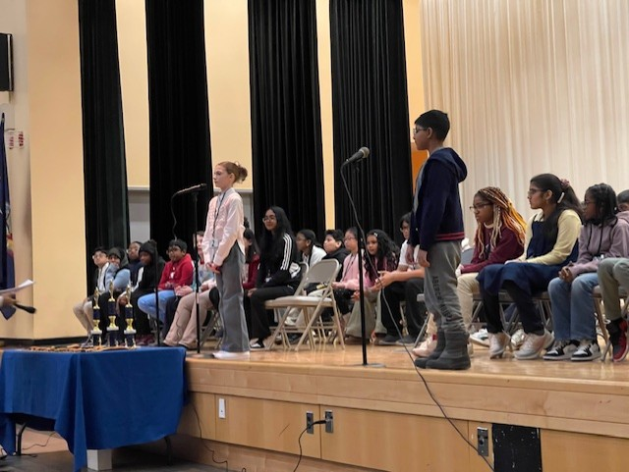
Literacy Proficiency
Math Proficiency
Chronic Absenteeism & Retention
Parent Engagement
Community
Superintendent
Dr. Eric L. Blake
Deputy Superintendent
Dr. Shonelle Hall
February 6, 2025
“With effort and support all schools can meet the needs of their students and help them achieve outstanding educational outcomes”

Slide 2
District 28 Vision, Mission & Goals
The United Nations' mission statement includes the line, "In this noble undertaking, cooperation, collaboration, unity, and solidarity must be the light we should seek and follow. We commit to strive for inestimable contribution to human progress."
Mission
In Community School District 28 we focus on equity as a lever for achievement for every single scholar. We are a district of excellence. We commit to every school maintaining high academic standards and working closely with families so that all scholars are learning at high levels. Beginning with school leaders, teachers, students and community partners, we also commit to being a district of learners ensuring that we promote critical thinking rooted in core content conceptual understanding through creative problem solving, technology innovation, social emotional learning and community advocacy.
Vision
In Community School District 28 we celebrate our differences because we understand that woven into those differences is the knowledge that they offer us unlimited possibility to learn and expand our knowledge of and commitment to all humanity. We are beautifully diverse, varied; coming from countless racial, ethnic, language, and belief backgrounds. We commit to striving for inestimable contribution to the lives of our scholars.

Slide 3
NYCPS Update on Immigration Policies
ALL Schools DIRECTED to follow the guidelines from the NYCPS and Mayor’s Office
These guidelines were messaged all Principals on Friday January 24th
District Attendance Coordinator, Goodman has presented updates to the following groups:
Principals Conference on 1/21/25
AP Conference on 1/28/25
D28 Trafficking Workshop – all Guidance Counselors / Social Workers / Parent Coordinators from D28 on 1/30/25
D28 Attendance Conference – 1/24/25
School Based PTA's – on 2/3/25 and another scheduled on 2/10/25

Slide 4
NYCPS Support
We are committed to supporting our students and families during these challenging times.
Safe and Welcoming Environment: Our schools are committed to being safe spaces where all students, regardless of immigration status, feel welcome and secure.
Counseling and Support Services: Our schools offer counseling and mental health services to support students and families dealing with stress and anxiety related to immigration issues.
Community Partnerships: We collaborate with local organizations to provide additional resources, such as legal assistance, housing support, and access to healthcare.
Communication and Outreach: We maintain open lines of communication with families, offering multilingual support and regular updates to ensure everyone is informed and feels supported.

Slide 5
Links to Resources for Families
These links will be posted on the CEC’s Website
NYC DOE Update on Immigration Procedures
Know Your Rights: Federal Immigration Enforcement
New York State Guidance on Safeguarding the Rights of Immigrant Students
Protections for Immigrant Families

Slide 6
D28 Attendance Snapshot​: 1/31/25
DCEP - Attendance Goals​
By June 2025, we will increase district-wide attendance by 2 percentage points from 90.7% to 92.7% excluding students who are long-term international travelers.​
By June 2025, we will reduce overall chronic absenteeism by 10% of overall Chronically Absent Students EOY 23/24 from 35% to 31%, excluding students who are long-term international travelers.​
​
Where are we Now: 1/31/25​
YTD Overall Attendance: 91.2% vs 90.0% Citywide​
STH YTD Attendance 87% vs 85.7% PRIOR YEAR
Chronic Absenteeism YTD: 32% vs 32.3% SAME DATE LAST YEAR, representing an overall slight decrease

Slide 7
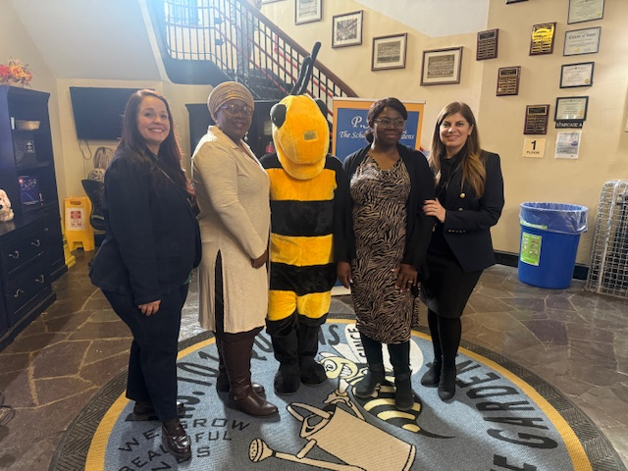
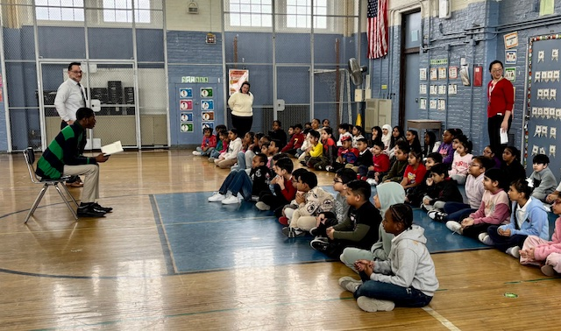
World Read Aloud Day 2025
Literacy is the foundation of lifelong learning and success, and we are deeply grateful to Chancellor Aviles Ramos's staff for visiting District 28 to inspire and engage our students through the joy of reading."

Slide 8
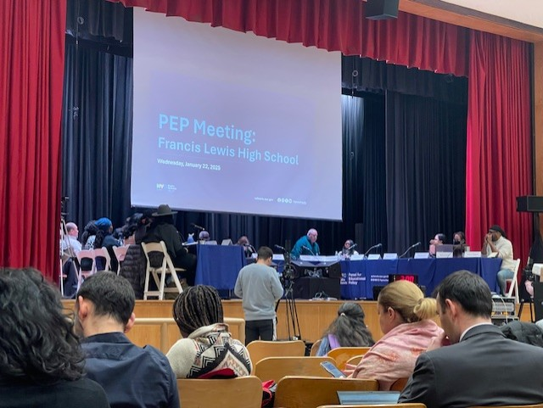
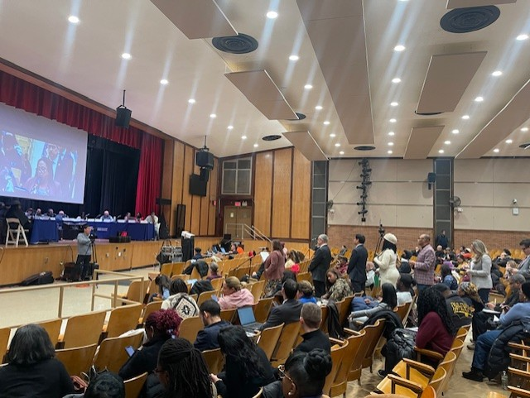
PS 99 Truncation
The proposal to truncate P.S. 099 Kew Gardens from a K-6 School to a K-5 School in building Q099 in the 2025-2026 School Year was approved by the Panel for Educational Policy on, January 22, 2025. Thank you to all stakeholders in making this process a seamless one.

Slide 9
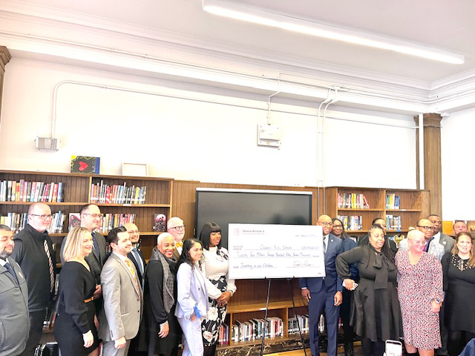
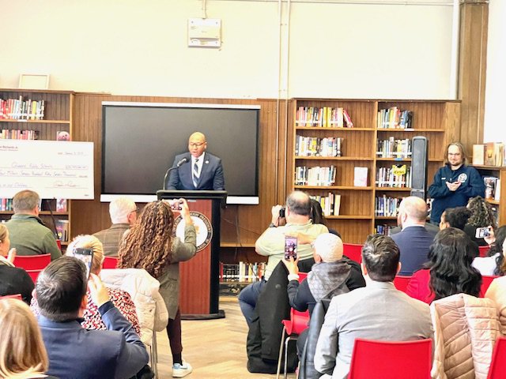
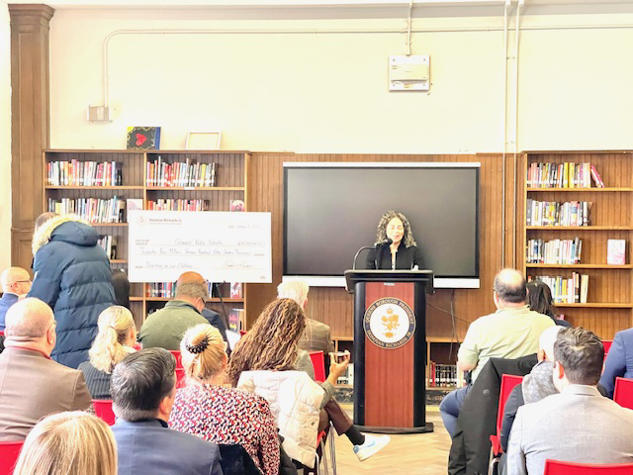
Queens Borough President, Donovan Richards
A huge thank you to Queens Borough President Donovan Richards, for allocating $25 million towards 50 projects in schools across Queens. Your continued advocacy and unwavering support for our families and community are deeply appreciated by all of us in District 28. We also want to thank his Director of Education, the amazing, Katerine Zapata for always answering the call.

Slide 10
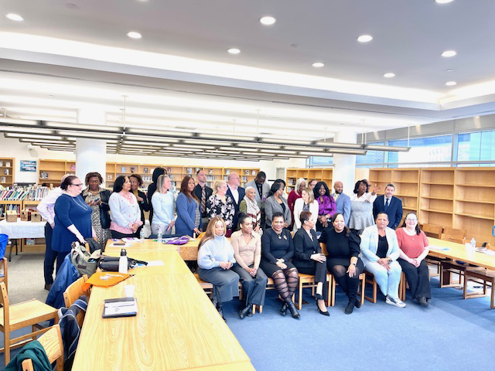
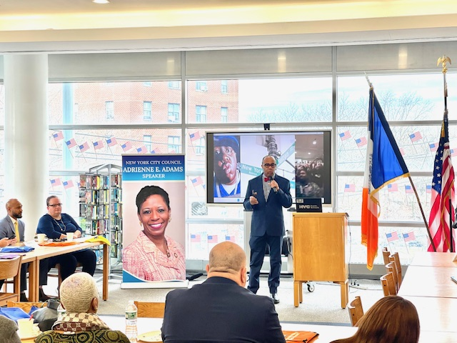
​NYC COUNCIL SPEAKER ADAMS’ ANNUAL PRINCIPALS GATHERING
The Principal’s Gathering is held to answer questions, share information, and support school administrators and staff with the Council Discretionary and RESO A Funding application process.
On behalf of the Superintendent’s office and our entire D 28 community, I want to take this opportunity once again to thank Speaker Adams and her incredible staff for her steadfast and unwavering support of our school community.

Slide 11
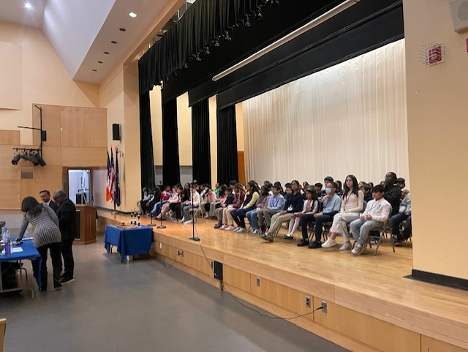
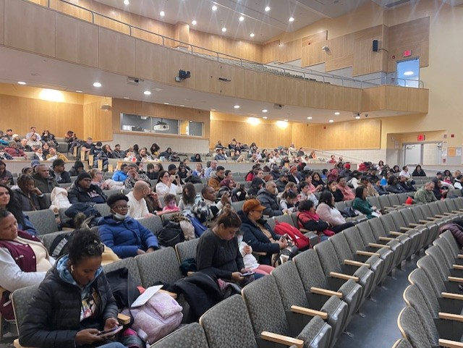
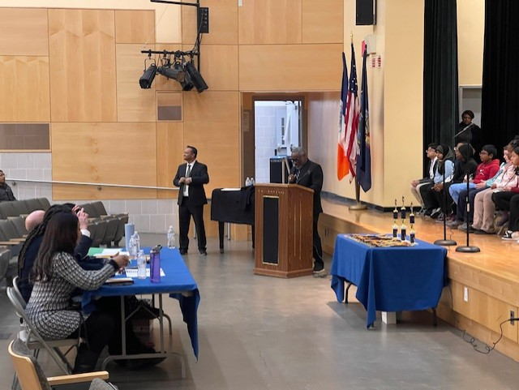
Queens South Spelling Bee
Congratulations to D28 Schools that participated, and congratulations to ALL students who participated from D27,D28, D29!
(28Q008, 28Q040, 28Q050, 28Q072, 28Q082, 28Q086, 28Q099, 28Q101, 28Q121, 28Q144, 28Q157, 28Q174, 28Q190, 28Q196, 28Q217, 28Q332 and 28Q354).
1st Place | Ricco Uviovo | 28Q217
2nd Place | Ayman Ayaat | 28Q680
3rd Place | Hanchen Zhao | 28Q101

Slide 12
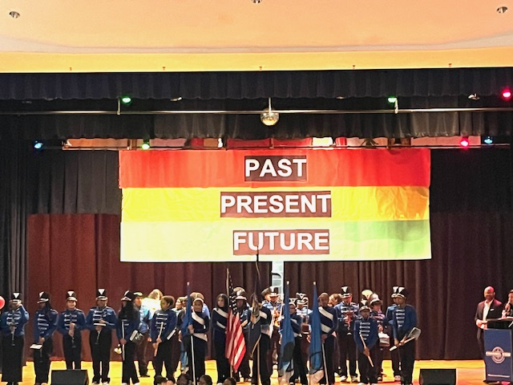
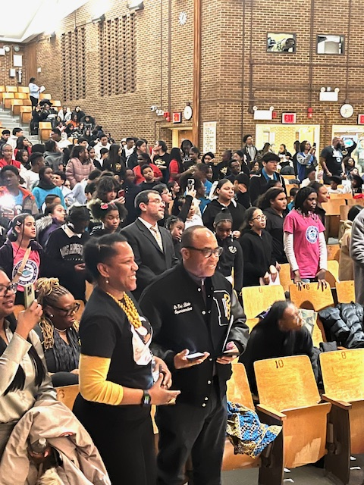
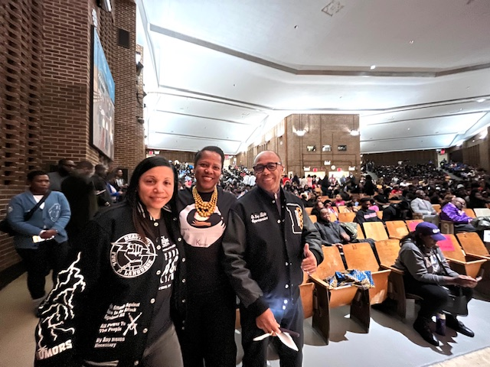
D28 MBK/MSK - HBCU Fair
In support of HBCU, Districts 27, 28, and 29 spearheaded by D28’s Keturah Hardy, held an event to introduce and elevate HBCU for our MBK/MSK Students. Elevating MBK/MSK and HBCU students is crucial for fostering leadership, academic excellence, and creating pathways to success for our young men and women of color. Thank you, Keturah and team ☺ !

Slide 13
Summer Rising Information Reminders
March 4th Summer Rising Application Opens
March 28th Summer Rising Application Closes
April 24th Summer Rising Results Shared With Families
May 8th Acceptance Deadline
RESOURCES
Learn more about the admission process.
MySchools

Slide 14
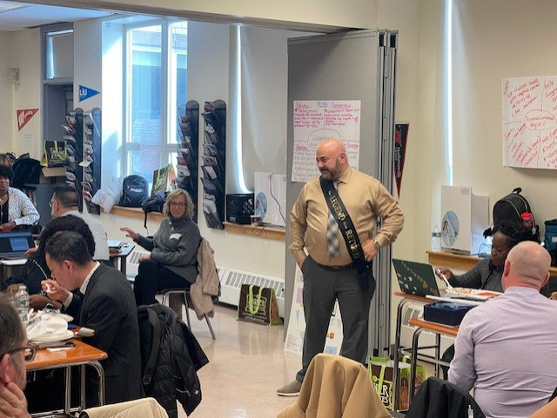
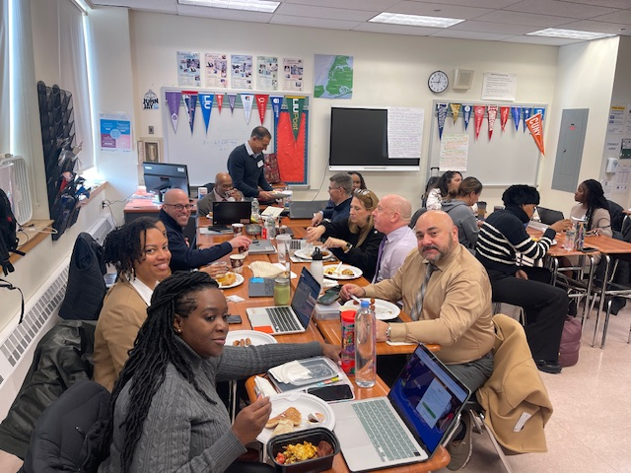
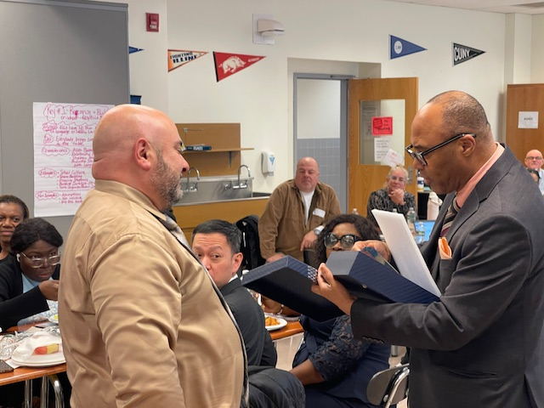
Thank you, Principal Suraci
Congratulations to Principal Vincent Suraci on his well-deserved retirement from JHS 157, and heartfelt thanks for his many years of dedicated service to our community! We also would like to welcome
Ms. Angela Ancona Lisa as Interim Acting Principal of JHS 157.

